Slide 1

Individual Project
(First Year )
Name: Krishnansu Mohapatra
Admn no.: 21JE0483

Slide 2
Understanding the problems
01
While driving on roads at hairpin section, many drivers face accident which results them into serious injuries or even death.
02
The main reason behind this accident is curves and bends of roads while turning in Ghats. It becomes difficult to see vehicles coming from other lane and turning drivers usually have to assume a way for turning at such critical section this creates a great risk of life .
The other reason for accident in hairpin section is that only one vehicle can turn at turnings at a time. If two vehicles come face to face while turning, it creates a chance of accidents and it becomes difficult to handle.
03

Slide 3
Idea And Approach
The project has been designed to prevent an accident by collision. This project proposes an idea to reduce the accidents and provide safety measuring techniques in hairpin curves using sensors, which detects the vehicles within 10 meters range of the curve using ultrasonic sensors. If a vehicle is at 10 meters from the curve, then the sensor will automatically sense the signal and gives the signal to the driver coming in the opposite direction with a LED light and a buzzer.

Slide 4
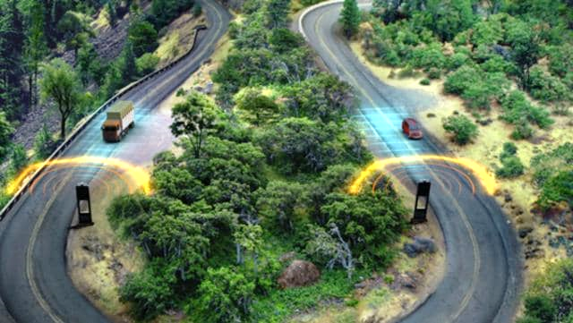
Demonstration in Real-time scenario

Slide 5
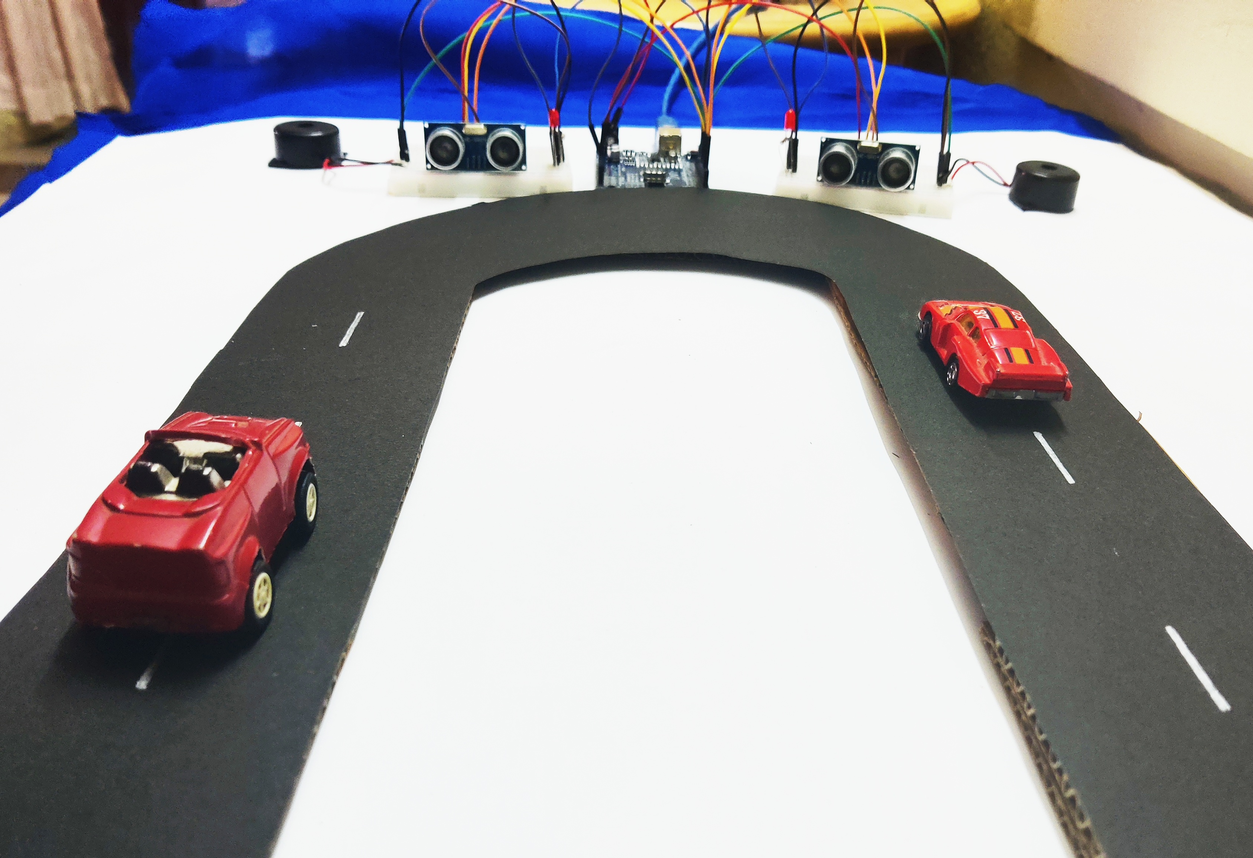
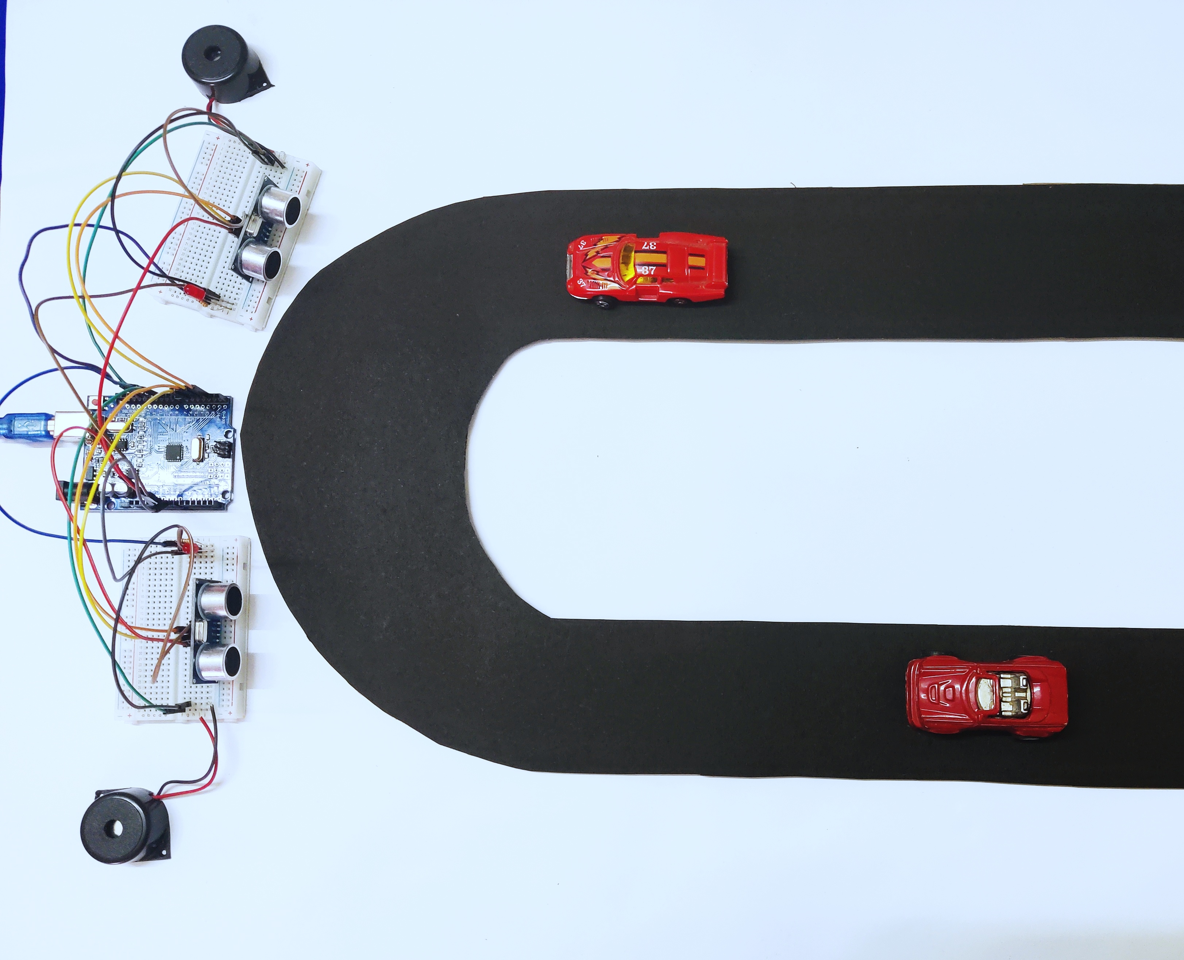
Working
It uses two Ultrasonic sensors, which are placed on either side of the hairpin bend. One sensor S1 is installed by the side of the uphill section of the road, similarly other sensor S2 is installed by the side of the downhill section of the road. Warning LEDs along with a Buzzer are placed at the either side of the curve of a hairpin bend. The sensors are mutually connected to Arduino Uno through wires. Based on the output of sensors, position of vehicles on either side of the bend is detected which is provided as an input to the Arduino. The Arduino Uno which works on a power supply of 7-12V runs and triggers the warning LEDs and the Buzzers and thereby intelligently controlling the movement of vehicles at the bend.

Slide 6
Components Required
Arduino UNO
HC-SR04 Ultrasonic sensor
LED
Buzzer
Connecting wires
Resistor
Breadboard

Slide 7
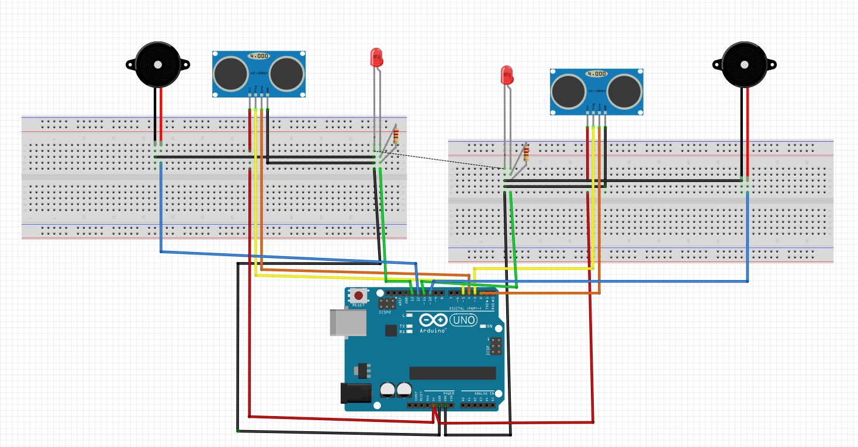
CONNECTION

Slide 8
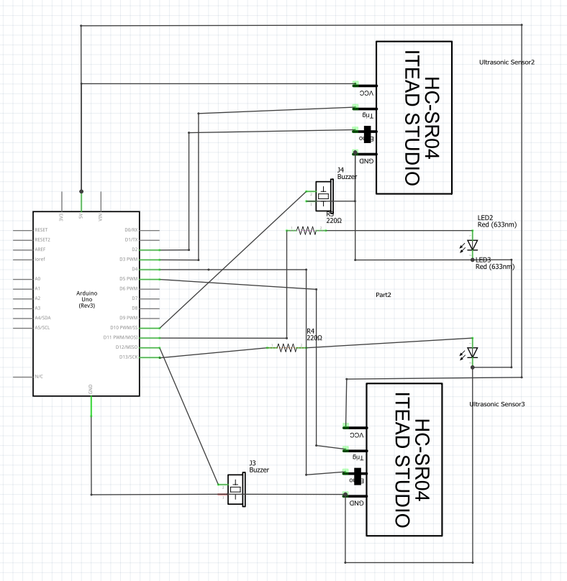
CIRCUIT DIAGRAM

Slide 9
PSEUDOCODE
#define ECHO_PIN1 2
#define TRIG_PIN1 3
#define buzzPin1 12
#define LED_Pin1 13
#define ECHO_PIN2 4
#define TRIG_PIN2 5
#define buzzPin2 10
#define LED_Pin2 11
void setup() {
Serial.begin(9600);
pinMode(LED_Pin1, OUTPUT);
pinMode(TRIG_PIN1, OUTPUT);
pinMode(ECHO_PIN1, INPUT);
pinMode(buzzPin1, OUTPUT);
pinMode(LED_Pin2, OUTPUT);
pinMode(TRIG_PIN2, OUTPUT);
pinMode(ECHO_PIN2, INPUT);
pinMode(buzzPin2, OUTPUT);
}
float readDistanceCM1() {
digitalWrite(TRIG_PIN1, LOW);
delayMicroseconds(2);
digitalWrite(TRIG_PIN1, HIGH);
delayMicroseconds(10);
digitalWrite(TRIG_PIN1, LOW);
unsigned int duration1 = pulseIn(ECHO_PIN1, HIGH);
return duration1 * 0.034 / 2;
}
float readDistanceCM2() {
digitalWrite(TRIG_PIN2, LOW);
delayMicroseconds(2);
digitalWrite(TRIG_PIN2, HIGH);
delayMicroseconds(10);
digitalWrite(TRIG_PIN2, LOW);
unsigned int duration2 = pulseIn(ECHO_PIN2, HIGH);
return duration2 * 0.034 / 2;
}

Slide 10
void loop() {
float distance1 = readDistanceCM1();
float distance2 = readDistanceCM2();
bool isNearby1 = distance1 < 25;
bool isNearby2 = distance2 < 25;
if(isNearby1)
{
digitalWrite(LED_Pin2, 1);
tone(buzzPin2, 250, 100);
}
else
{
digitalWrite(LED_Pin2, 0);
}
if(isNearby2)
{
digitalWrite(LED_Pin1, 1);
tone(buzzPin1, 250, 100);
}
else
{
digitalWrite(LED_Pin1, 0);
}
Serial.print("Measured distance1: ");
Serial.println(readDistanceCM1());
Serial.print("Measured distance2: ");
Serial.println(readDistanceCM2());
delay(200);
}

Slide 11
TAKEAWAYS
PROBLEMS FACED:
Choosing the right microcontroller and the suitable sensor.
Learnings:
Got to learn about development boards and sensors which can be used for various purposes.
REMARKS:
The proposed bot is a prototype for the bot which can be actually used in real time situation to solve the issue(prevention of accidents).

Slide 12
RESOURCES
https://create.arduino.cc/projecthub
https://wokwi.com/
https://www.youtube.com/watch?v=vT4m3BAHZTw
Fritzing software
https://wokwi.com/projects/338043874909880915 (Simulation of the bot)

Slide 13
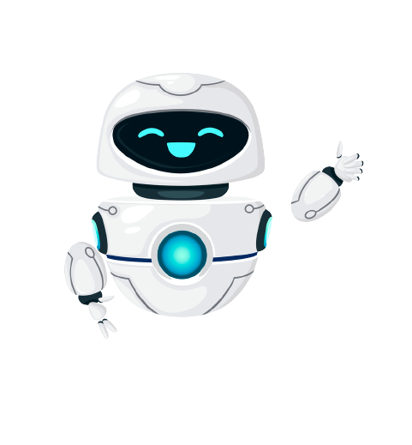
Thank you!

